Slide 1
Occupational Life Skills Citizenship & Sustainability
Cyndie-Lea Wang

Slide 2
Creating Common Language
People
Profit
Planet
Bearable
Equitable
Sustainable
Viable

Slide 3
Define unique contributions our community can make

Slide 4
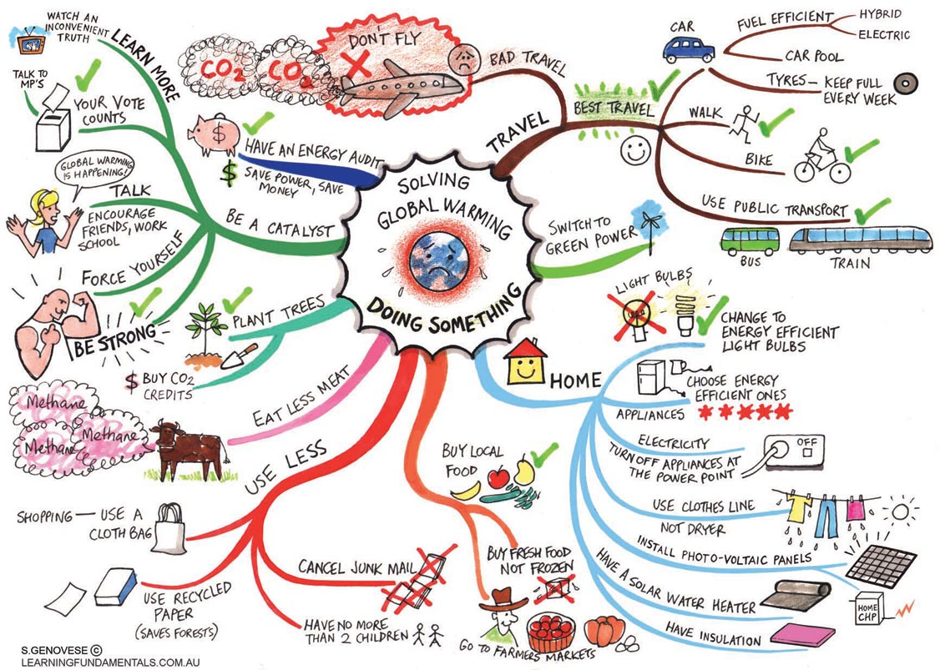
Create Class and Individual Action Plans

Slide 5
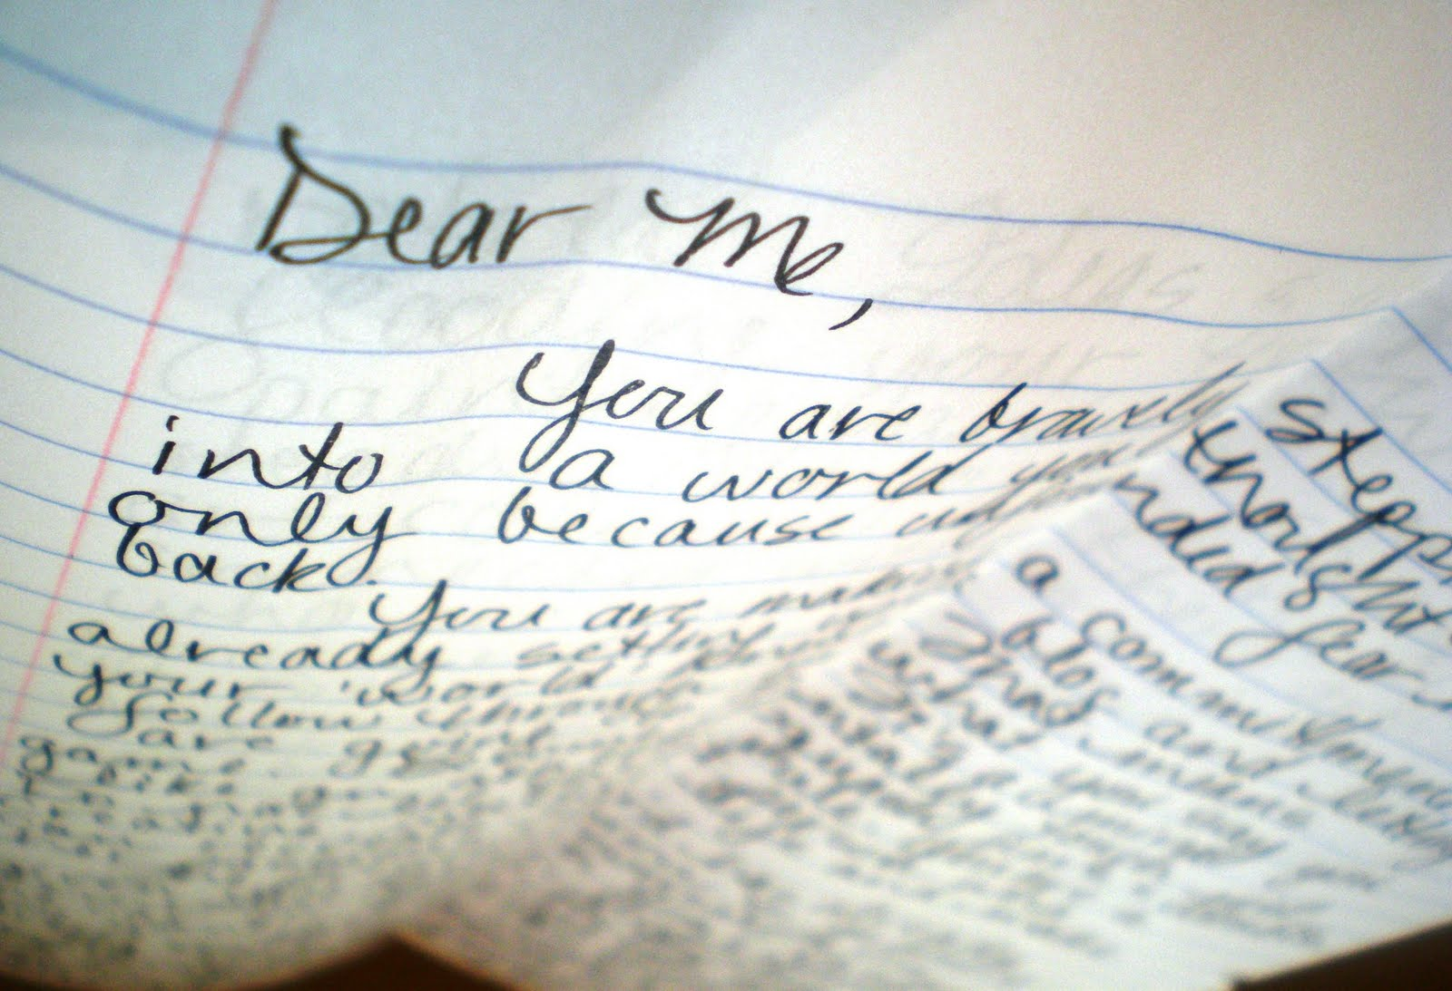
Stay motivated

Slide 6
Questions or feedback?

