Slide 1
“They Never Told Me What to Expect, so I Didn’t Know What to Do”
Defining and Clarifying the Role of the Community College Student
by Melinda Mechur Karp & Rachel Hare Bork
Community College Research Center
July 2012

Slide 2
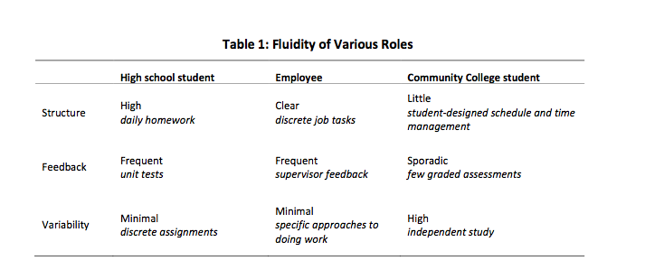
Compared to high school & work, the CC role is less structured, more flexible, receives less feedback

Slide 3
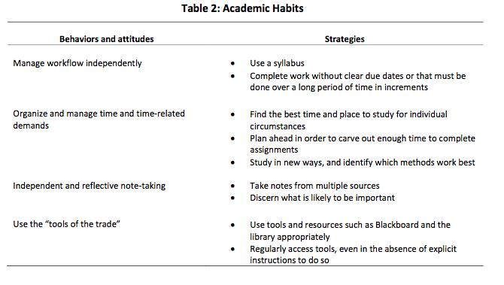
Academic habits that professors expect CC students to exhibit

Slide 4
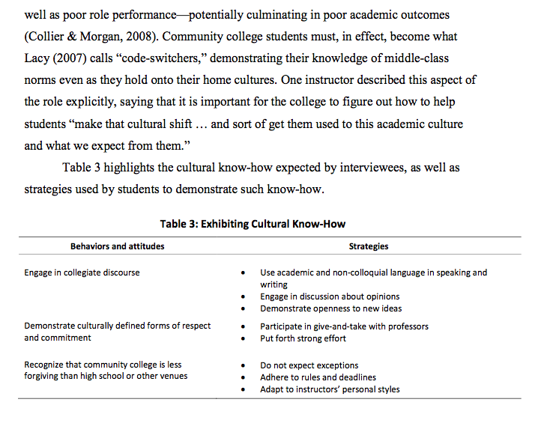
CC students expected to develop and use (white middle-class) cultural know-how

Slide 5
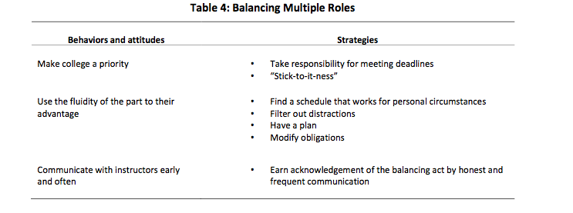
CC students expected to show they can balance multiple roles

Slide 6
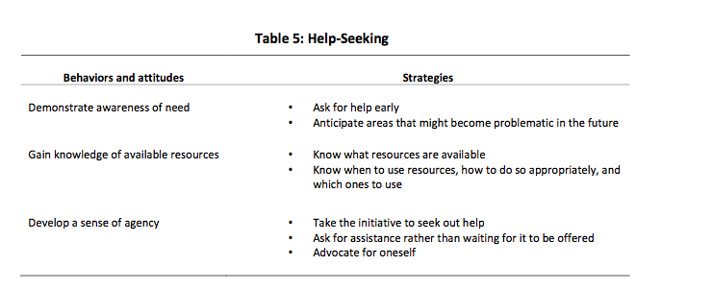
CC students expected to know 3 components of the help-seeking process

